Slide 2



?

Slide 3
Retrieval Augmented Generation (RAG)

Slide 4




?
?
+

Slide 5
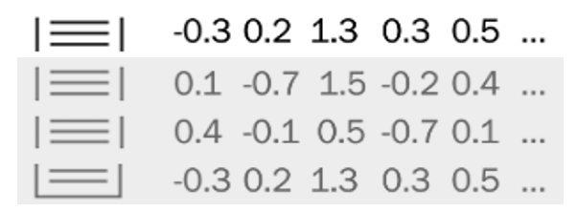


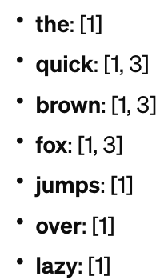

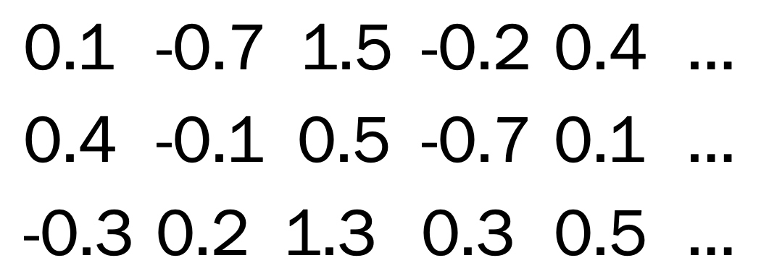
?
?
+
indexing
embedding
chunking
collection

Slide 6
?
?
+
Query formulation
Hand-off
Context analysis
Query generation
Combining inputs
Contextual guidance
retrieval
Document search
Document processing
Index querying
Ranking and selection
Preprocessing
Context integration

Slide 7
?
?
+
retrieval
indexing
collection

Slide 8


RAG Retrieval Augmented Generation
Key libraries

Slide 9
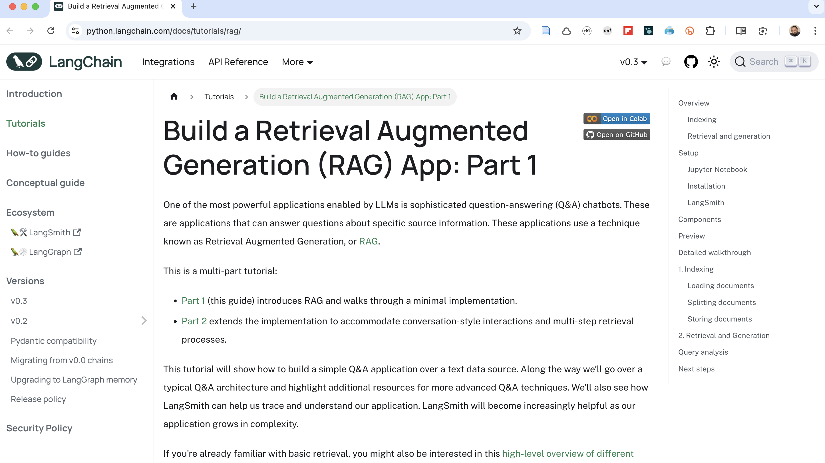

Slide 10
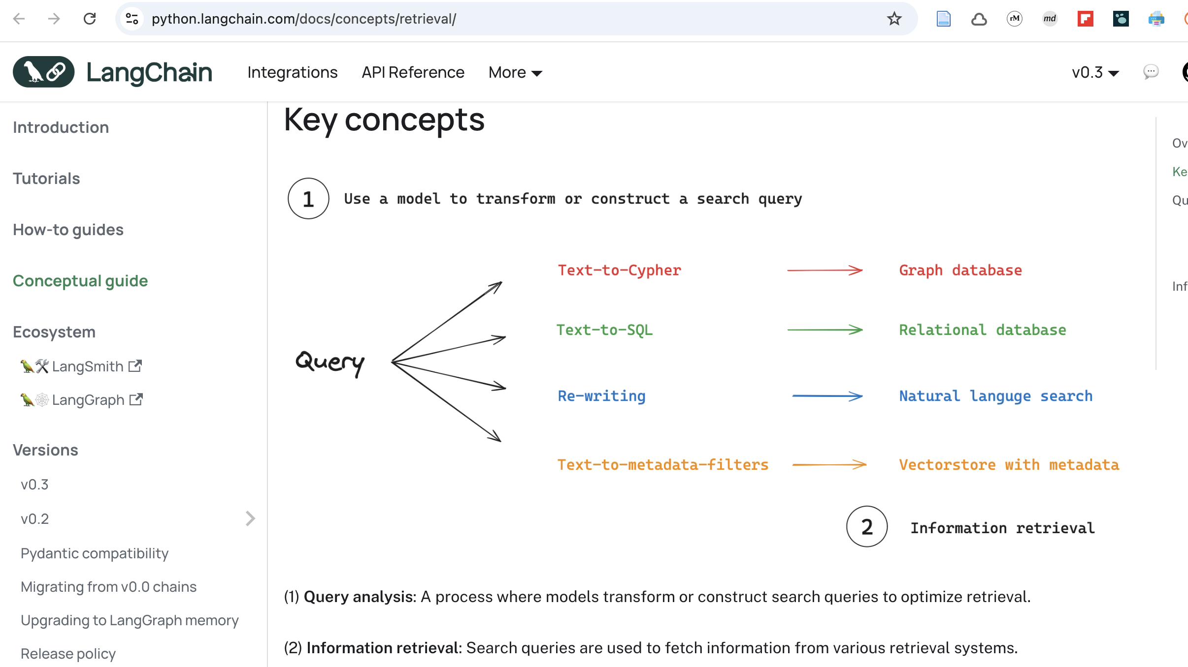

Slide 11
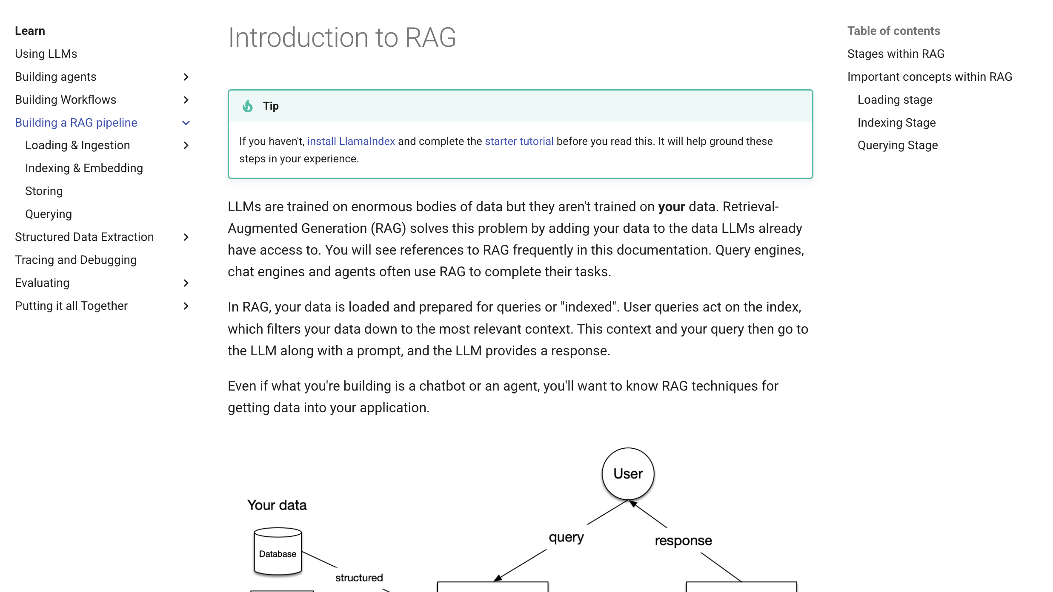

Slide 12
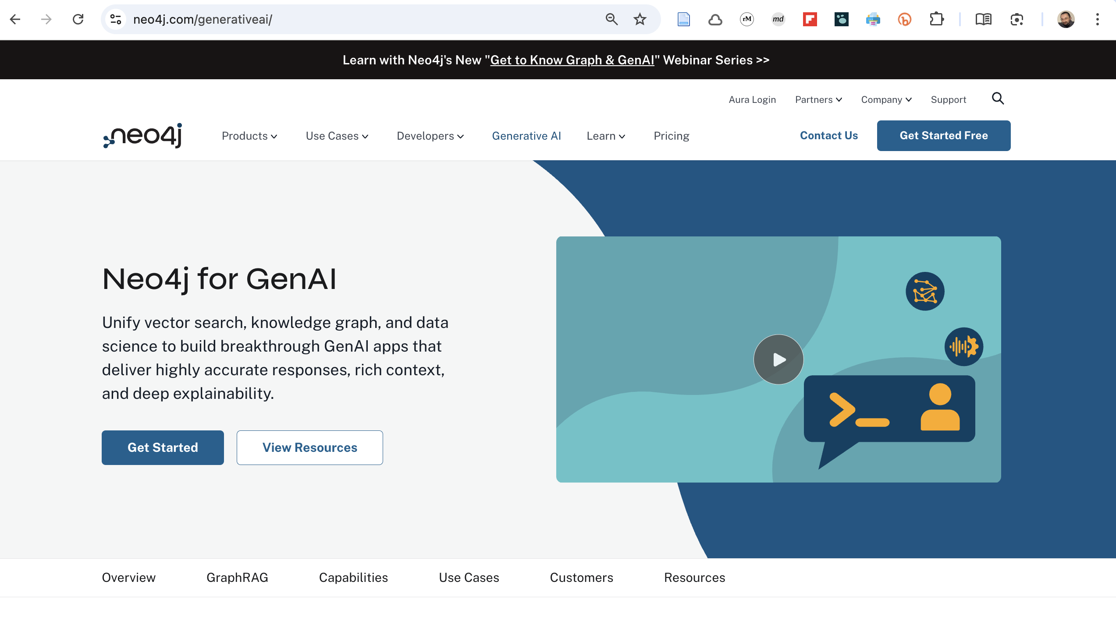

Slide 13

Complicatons?

Slide 14


Loading
text
image
video

Slide 15


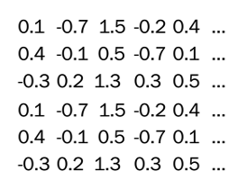

text
TXT embedding model
embedding
Indexing
image
IMAGE embedding model
embedding
video
VIDEO embedding model
embedding
Search based on vector similarity

Slide 16
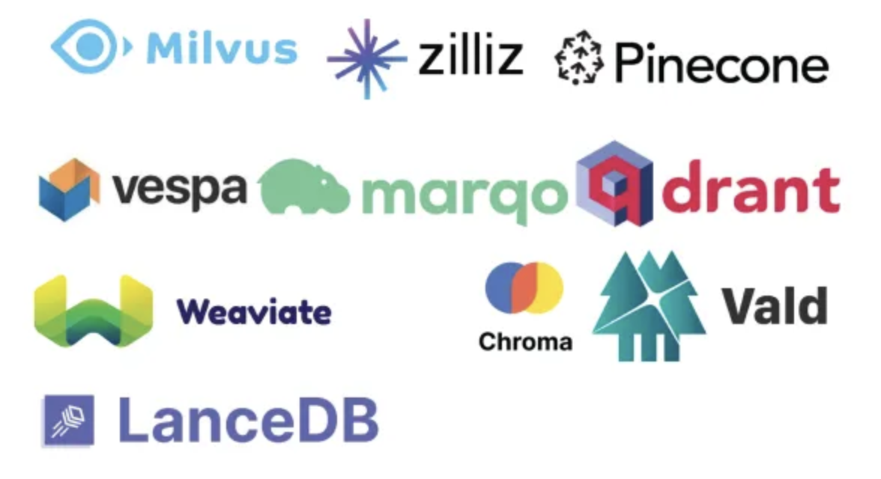
Vector databases

Slide 17
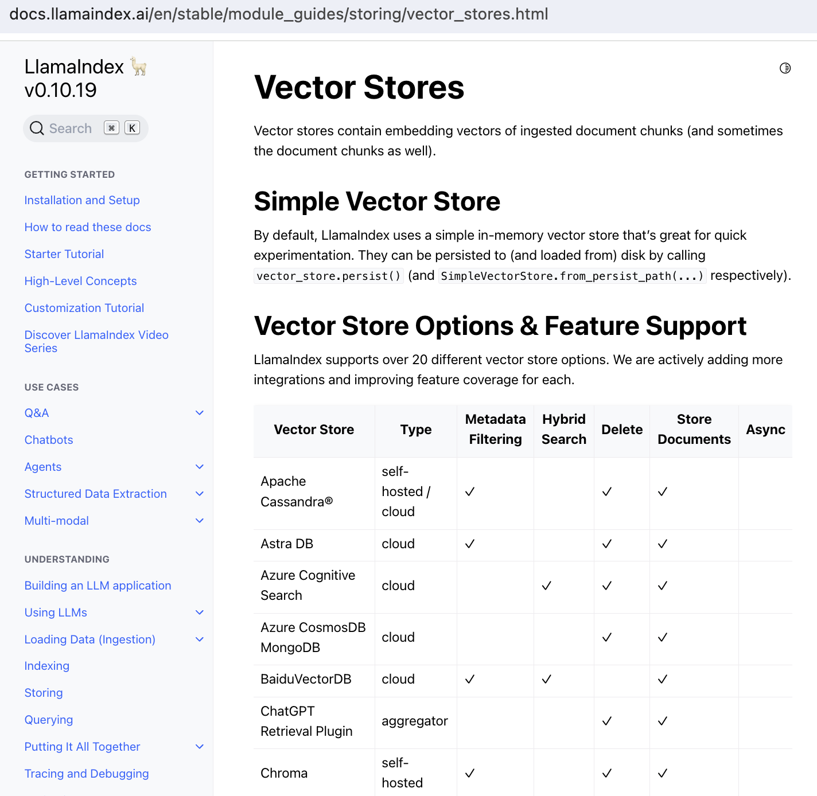
Vector databases

